Slide 1

Bike Showroom Management System
Asmita Adhikari
NCCID: 00172902

Slide 2

Introduction
Software of Bike Showroom could management system of showroom.
Software tools facilitates for keeping records of bike available inside showroom.
Bills are generated.
Admin could manage bills, add product update it and also delete.

Slide 3
Problem Statement
Problem of existing system
Convert manual work with computerized system.
Remove all paper work.
Customer’s could interact with system easily.
Reduce manpower.

Slide 4
Background of project
Customers could read information about products.
Software is used to provide information about available bikes on showroom.
Admin manages all the stock available in the showroom.
Admin could insert, updates, deletes products.

Slide 5
Aims and objective
For customer’s convenient.
Managing showroom activities.
To replace with old methodology.
To manage time.
To reduce number of manpower.

Slide 6
Features of project
Admin Dashboard
User and admin logged in
View products:
Add products
Update products
Delete products
Bill print
Search engine
View order

Slide 7
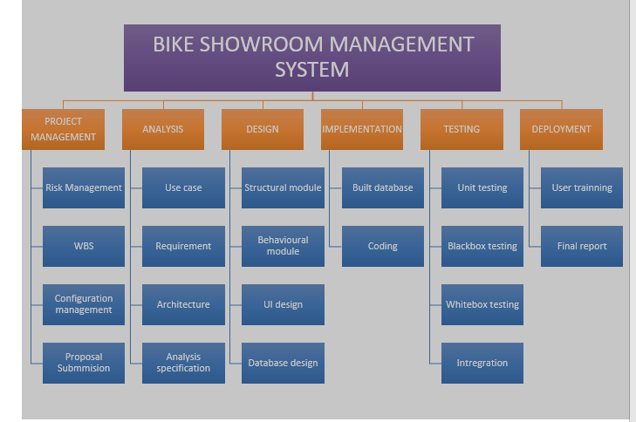
WBS (Work Break-down Structure)

Slide 8
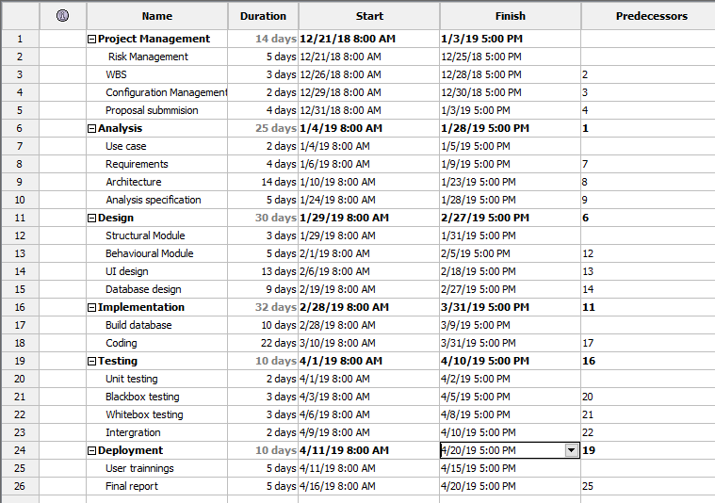
Gantt-Chart

Slide 9
Architecture
Model View Controller (MVC) is used for application development.
Model: It contains pure application data which doesn’t concern UI or presentation.
View: It present model data to user in a proper interface and allows user to manipulate data.
Controller: controller is between model and view. View is updated when model changes and model is updated when user manipulates the view.

Slide 10
Development Methodology
Waterfall model
Each phase has its own distinct goals.
Each phase would be complete in definite deadline.
Easy to manage.
Completed in one time and phases don’t overlap.

Slide 11
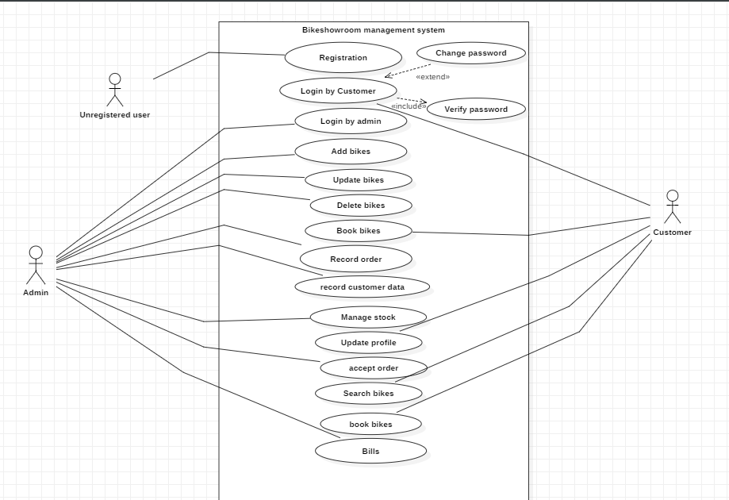
Use Case

Slide 12
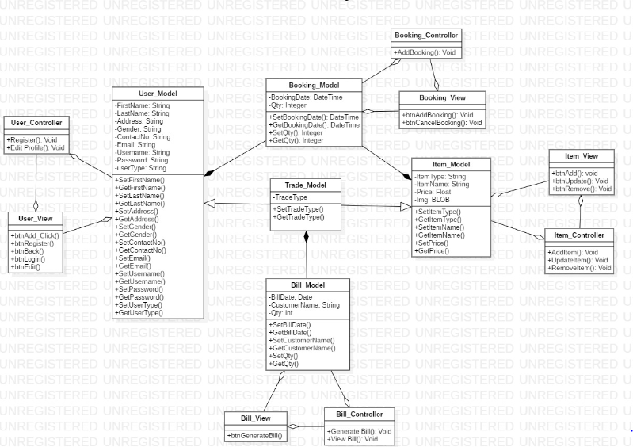
Final-Class diagram

Slide 13
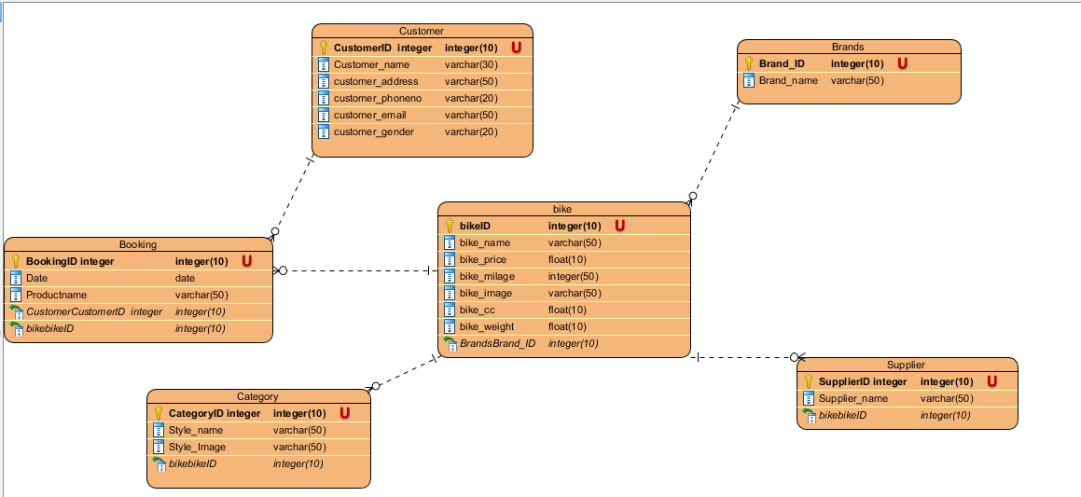
ER- diagram

Slide 14
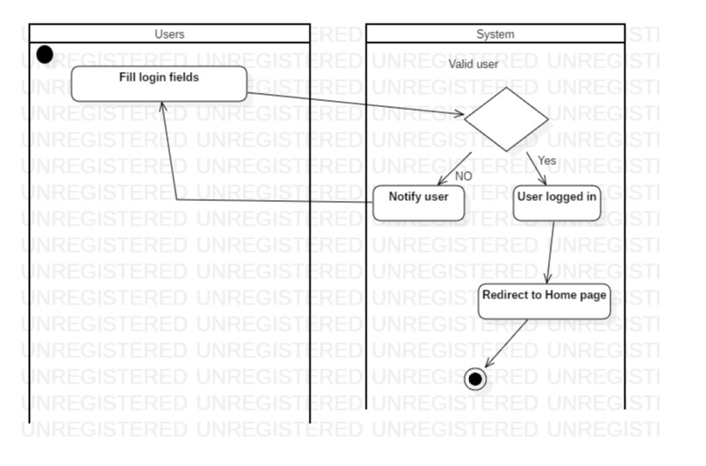
Activity Diagram

Slide 15
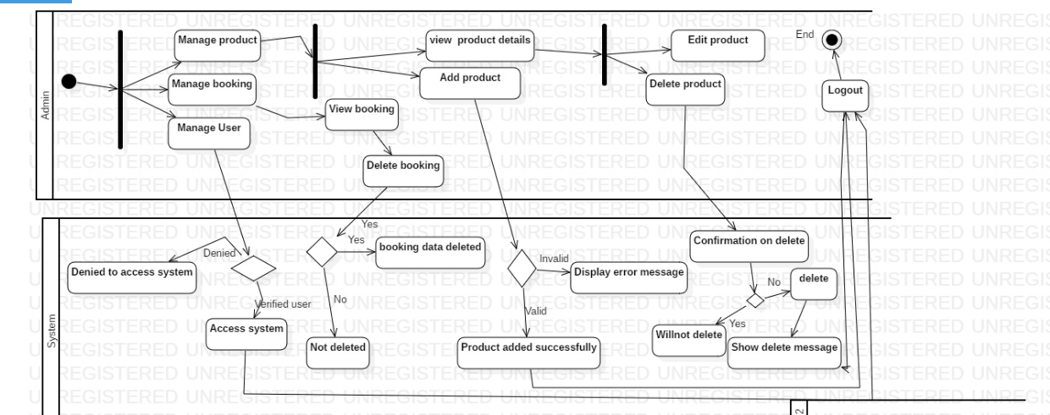
Activity diagram

Slide 16

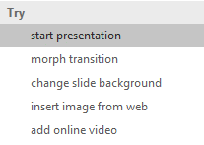

More questions about PowerPoint?
Select the Tell Me button and type what you want to know.
Visit the PowerPoint team blog
Go to free PowerPoint training
SELECT THE ARROW WHEN IN SLIDE SHOW MODE

